Slide 1
Introduction to C

Slide 2
C origins
C is a general-purpose programming language that was originally developed by Dennis Ritchie at Bell Labs in the early 1970s. It was designed to be a low-level language that could be used to write operating systems, compilers, and other system software. C is known for its speed, efficiency, and low-level memory manipulation capabilities, as well as its simple syntax and ease of portability across different hardware platforms.
Over time, C became increasingly popular and was widely adopted as a general-purpose programming language for a variety of applications, including system programming, game development, scientific computing, and web development, among others.
C has influenced many other programming languages, including C++, C#, Java, Python, and many others. Today, C remains an important programming language, particularly in systems programming and embedded systems development, where its efficiency and low-level control are highly valued.

Slide 3
Setting it up
We are going to be using Visual Studio for learning C programming. The reasons for this are that it avoids having to download and install a separate compiler in Visual Studio Code, and C programs can be run within a C++ template within Visual Studio.
Open Visual Studio and make a new project. From the top-right dropdown menu, select C++ Console App, then set the name and save location to whatever you want.

Slide 4
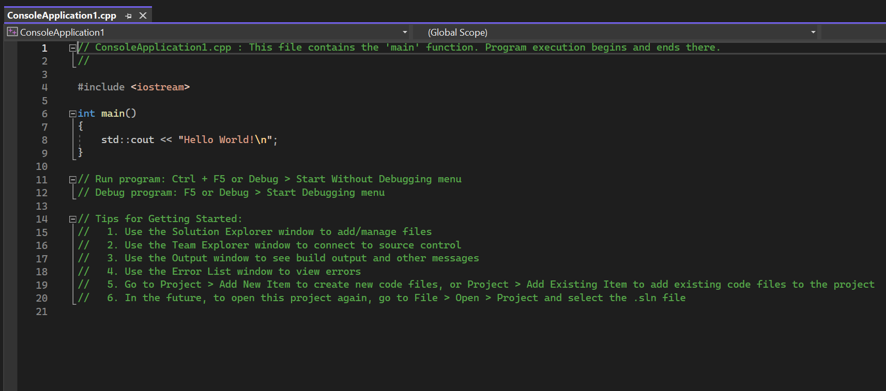
Setting it up
The program will initially look like this:

Slide 5

Setting it up
In order to run a C program in C++, we need to make a small change:
Remove <iosteam> and replace with <stdio.h>

Slide 6
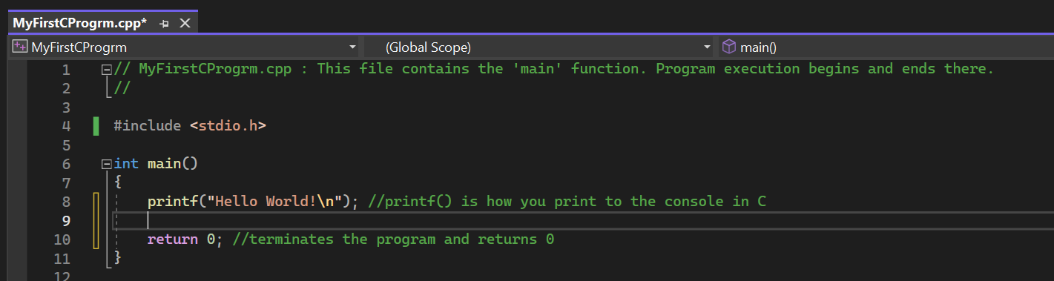
Input/output
In C, the two most common commands for input/output are printf() and scanf().
scanf() is used to read input data only. It does not print.
printf() is used to output (print) data to the console.

Slide 7
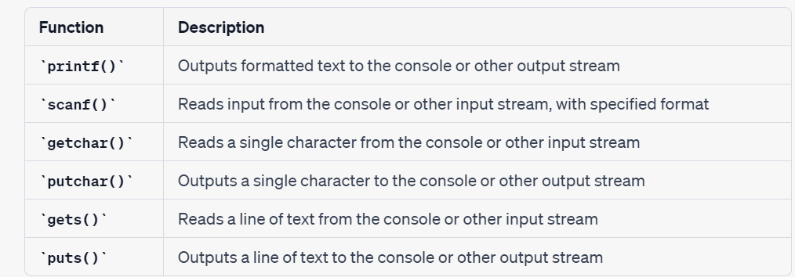
Input/output
Here is a table showcasing some of the other common input/output types in C:

Slide 8
Input/output
Like many other programming languages, a semicolon ‘ ; ’ is used to terminate a statement.
Curly braces ‘ { } ‘ are used to enclose blocks of code, and to indicate the start and end point of functions, loops, and if statements.
In C, ‘return’ is used to exit a function and return an integer value. In the main function above, the 0 is used to indicate that the program ran successfully without errors. Any other value indicates an issue.

Slide 9
Variables / Data Types
C is a statically typed language, meaning that each variable must have a data type specified when the variable is declared.
There are several basic data types, with many variations that are not as commonly used. We will focus on the most common data types.

Slide 10
Variables / Data Types
The basic data types in C are:
int: used for whole number integers, such as 1, 2, 3 etc.
float: used for floating-point numbers (numbers with decimal points, such as 1.5). Floating point numbers are accurate to about 7 digits after the decimal point.
double: used for “double precision” floating-point numbers, which means it has double the memory capacity as a float, and has a precision of about 15-16 digits after the decimal point
char: used for single characters, such as a, b, c
void: used to represent the absence of a specific type

Slide 11
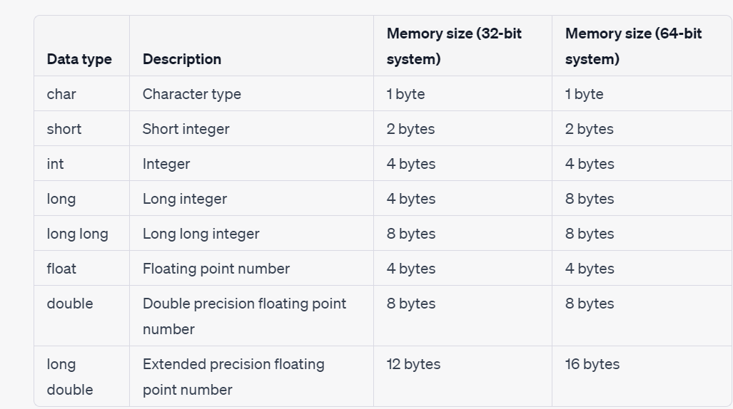
Variables / Data Types
Here is a table that lists the C data types and their memory utilization:

Slide 12
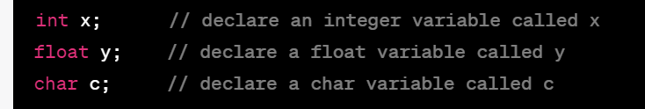
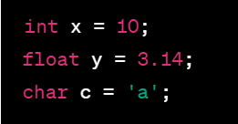
Variables / Data Types
Variables can also have their value initialized at the time of declaration:

Slide 13
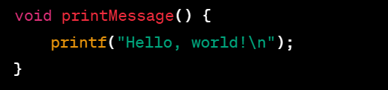
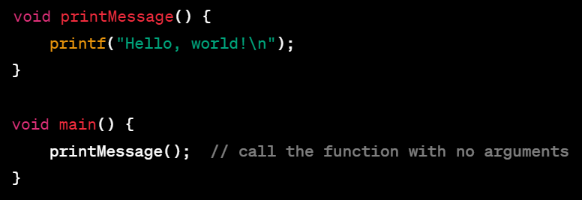
Variables / Data Types
In terms of the void data type, this is a valid data type in C, and is commonly used to indicate that a function does not return a value. In this example, note that we do not end the function with a return.
Void can also be used to indicate that a function doesn’t take any arguments.

Slide 14
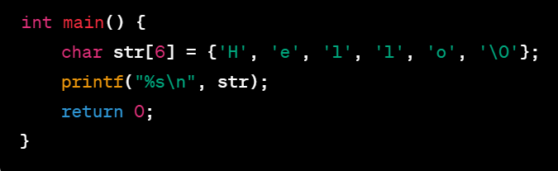
Variables / Data Types
A note about strings: Unlike other programming languages, “string” is not a built-in data type in C programming. Instead, strings are represented as an array of characters. There are two ways to go about this, a hard way and an easy way.
The hard way is to declare the length of the array using individual characters enclosed in single quotes like this, which is inconvenient and terrible for so many reasons:
With this method, it is also necessary to explicitly include a null character ‘\0’ that terminates the string.

Slide 15
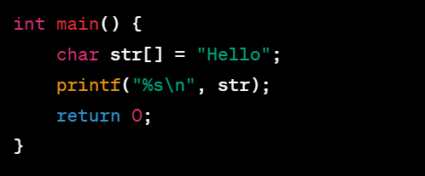
Variables / Data Types
The easier and more convenient way is to use string literals. With this method the value of the string is enclosed in double quotes. The null ‘\0’ character does not need to be explicitly included, because the compiler implicitly adds it to the end of the string automatically. This is much more convenient.
Note that in both examples, %s is used to indicate that a string will be passed as an argument to a function, in this case the printf() function. The \n is what is called an “escape sequence” and indicates a new line.

Slide 16
Variables / Data Types
In C, when printing to the console using printf() you must use a ‘conversion specifier’ that tells the function how to interpret the data and how to format it when printing. The conversion specifiers are as follows:
%d : This is used to indicate an integer data type.
%f : This is used to indicate either a float or double data type.
%c : This is used to indicate a character data type.
%s : This is used to indicate a string data type.

Slide 17
Operators – Arithmetic
In C, the basic arithmetic operators are as follows:
+ Addition: This adds two values together.
- Subtraction: This subtracts a value from another value.
* Multiplication: This multiples two values together.
/ Division: This divides one value by another value.
% Modulo: Computes the remainder (if any) when one value is divided by another.

Slide 18
Operators – Logical
In C, the basic logical operators are as follows:
= : This is the assignment operator and “assigns” a value to a variable.
== : This is the equality operator, and indicates a variable is equal to a specified value.
!= : This is the inequality operator, and indicates a variable is not equal to a value.
> : Greater than. This indicates the value on the right is greater than the value on the left
< : Less than. Indicates the value on the left is greater than the value on the right.
>= : Greater than or equal. Indicates the value on the right is equal to or greater than the value on the left.
<= : Less than or equal. Indicates the value on the left is equal to or less than the value on the right.

Slide 19
Operators – Logical
&& : This is the AND logical operator, which returns a true value only if both operands are true.
|| : This is the OR operator, which returns true if at least one condition is true.
! : This is the NOT operator, which is basically a reverse UNO card. If a condition is true, it will return false, and if a condition is false, it will return true.

Slide 20
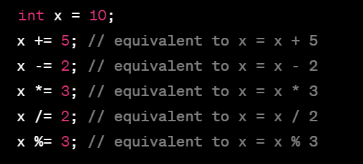
Operators – Shorthand
In C, there are also several shorthand operators, which can be used to simplify code and make it easier to read and understand.

Slide 21
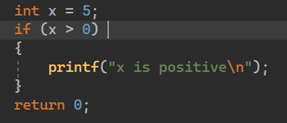
Conditionals - if statements
Conditional statements are used to control the flow of a program. In C, the two main conditional statements are ‘if’ statements, and ‘switch’ statements.
‘if’ statements allow you to execute a certain block of code if a certain condition is true. If the condition is false, the code will not run.

Slide 22
Conditionals - if statements
‘if’ statements can be expanded by adding ‘else if’ and ‘else’ statements.
‘else if’ statements provide an alternative “choice” of code for the program to run if the initial condition is not true. You can have multiple else if statements.
An ‘else’ statement functions as a final decision and will be executed if none of the other ‘if’ and ‘else if’ statements are true.

Slide 23
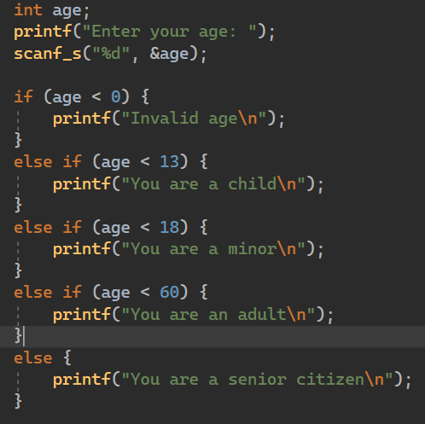
Conditionals - if statements
In this example, we have an if statement, two else if statements, and a terminating else statement. The final output will be different depending on the number input for ‘age’.

Slide 24
Conditionals – switch statements
A ‘switch’ statement is a way to check a variable against a set of possible values, and to run different code depending on the value specified. It’s like a series of ‘if’ statements, but more concise.
You list the possible values in ‘case’ statements, and the code to run if the variable value matches the “case label” in that code block.
Cases are separated by a ‘break’ statement used to exit that case block and exit to the end of the ‘switch’ statement. Without a ‘break’ statement, the program execution would “fall through” to the next case until either a ‘break’ is found, a ‘default’ statement is found, or the ‘switch’ statement terminates.
You can use a ‘default’ block to specify what to do if none of the ‘case’ statements match, just like how an ‘else’ statement works.

Slide 25
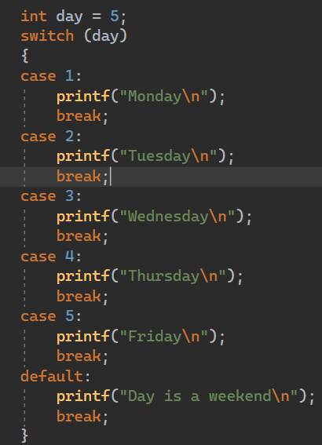
Conditionals – switch statements
In this case (haha) the output would be “Friday”, because the value of day is 5, which matches the case label 5, so the code in that block is executed.
Generally speaking, ‘switch’ statements are less commonly used than regular ‘if’ statements, but it is good to understand how they function in case (!) you come across them in the wild.
Bad puns are generally not welcome. Anywhere.

Slide 26
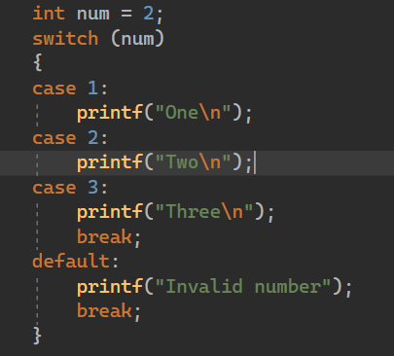
Conditionals – switch statements
Here is an example of the “falling through” behaviour with a switch statement. Here, the output would read ‘two three’. This is because the value of num is 2, and each case us evaluated sequentially, starting with case 1. Since there is no break statement after the printf("Two\n"); statement, the program will continue executing the statements in the following cases until it encounters a break statement

Slide 27
Loops
Loops are used to execute a block of code repeatedly until a certain condition is met. They are useful for automating repetitive tasks, such as processing large amounts of data or performing calculations.
Loops can save a lot of time and effort by eliminating the need to write out the same code multiple times. They also make code more efficient by allowing you to process data in bulk, rather than one element at a time.
There are three main types of loops in C: while, do-while, and for loops. Each type of loop has its own structure and is used for different scenarios.

Slide 28
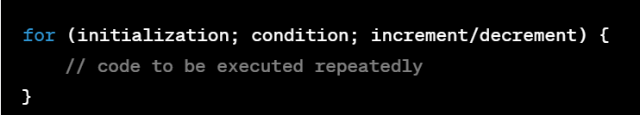
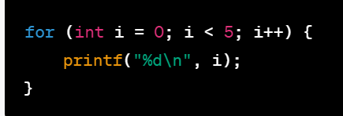
For Loops
For loops are used when you know the exact number of times you want to execute the code block, such as when iterating over an array or other data structure.
The basic structure of a "for" loop is as follows:
The "initialization" step is used to declare and initialize a loop variable. The "condition" step is used to specify the condition that will be checked each time the loop is executed. The loop will continue to execute as long as this condition is true. The "increment/decrement" step is used to modify the loop variable on each iteration of the loop.

Slide 29
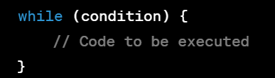
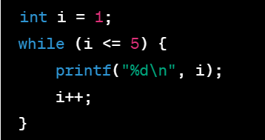
While Loops
While loops are used when you want to execute a block of code repeatedly, as long as a certain condition is true.
In a while loop, the condition is evaluated before each iteration of the loop. If the condition is true, the code inside the loop is executed. After the code is executed, the condition is evaluated again, and the process repeats until the condition is false. It is important to make sure that the condition will eventually be false, in order to avoid an “infinite loop”.
The basic structure of a while loop in C looks like this:

Slide 30
Do-While Loops
A do-while loop in C is another type of loop that is similar to the while loop, but with one key difference. In a do-while loop, the code inside the loop is executed at least once, regardless of whether the condition is true or false.
In a do-while loop, the code inside the loop is executed first, and then the condition is checked. If the condition is true, the loop will continue to execute, otherwise the loop will terminate.
Do-while loops are useful for situations where you want to execute a block of code at least once, and then continue to execute the code as long as a certain condition is true.
Like regular while loops, it is important to make sure the condition will eventually become false to avoid an infinite loop.

Slide 31
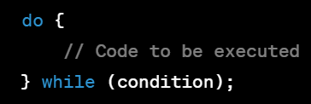
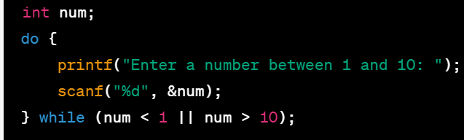
Do-While Loops
The basic structure of a do-while loops is as follows:
In this code, the loop will continue to prompt the user to enter a number until the user enters a number between 1 and 10. The code inside the loop is executed at least once, regardless of whether the user enters a valid number or not.

Slide 32
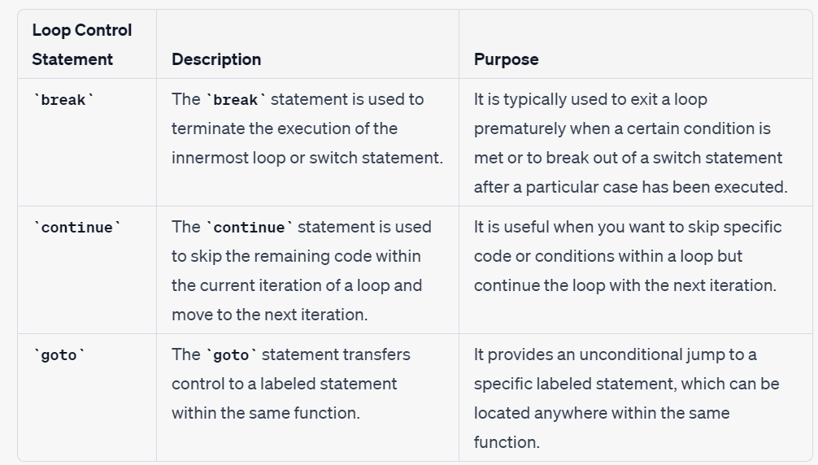
Loops – Control statements
In addition to the different types of loops, there are also what are known as loop ‘control statements’. These are used within the body of the loop to modify the the loop to obtain specific behaviour or conditions , such as when you want the loop to stop iterating after a certain thing happens.

Slide 33
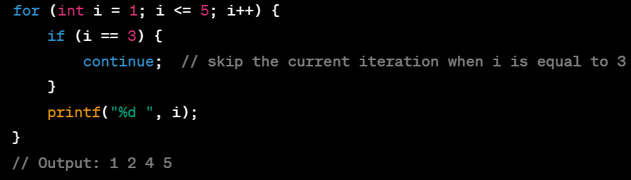
Loops – Control statements
Note that the use of ‘goto’ statements is generally discouraged, and should be avoided in most cases, as it can lead to complex and confusing code that is harder to debug and maintain.

Slide 34
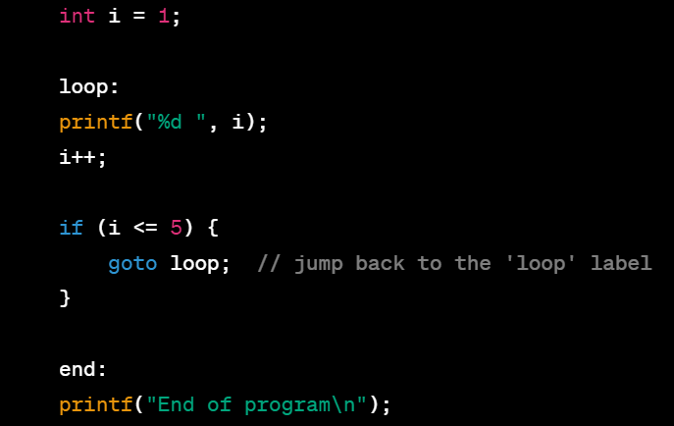
Loops – Control statements
Note that the use of ‘goto’ statements is generally discouraged, and should be avoided in most cases, as it can lead to complex and confusing code that is harder to read, debug and maintain.

Slide 35
Arrays
As in other programming languages, Arrays in C are a fundamental data structure used to store multiple elements of the same data type. They provide a contiguous block of memory where elements are stored in consecutive locations. Each element in the array can be accessed using an index, which represents the position of the element within the array.
Arrays are widely used in C programming to store and manipulate collections of data efficiently. They provide a compact and structured way to organize data and allow for various operations like sorting, searching, and processing data in a systematic manner.
Here are some important aspects about arrays in C:
Memory Allocation(Declaration): When you declare an array, the compiler allocates memory for the specified number of elements based on the data type. The size of each element is determined by the data type of the array. For example, if you have an array of integers, each element will typically be 4 bytes in size.
Indexing: Elements in an array are accessed using indices starting from 0. The index indicates the position of an element within the array. For example, in an array called numbers[5], the first element is numbers[0], the second element is numbers[1], and so on. You can use the index to read or modify the value of a specific element.
fd

Slide 36
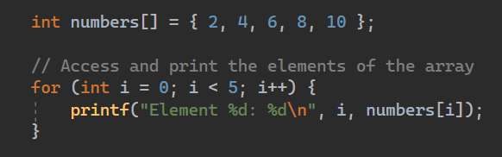
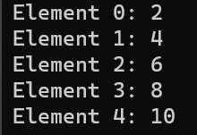
Arrays
fd
Initialization: Arrays can be initialized when declared or later using assignment statements. During initialization, you can provide a list of values enclosed in curly braces {}. The number of values provided should match the size of the array. For example, int numbers[] = {1, 2, 3, 4, 5}; initializes an array of integers with five elements.

Slide 37
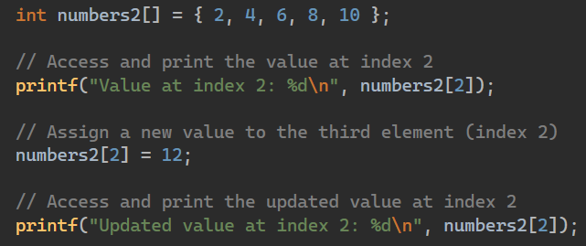

Arrays
Accessing Elements: You can access individual elements in an array using the array name followed by the index enclosed in square brackets. For example, numbers[2] gives you the value at index 2 in the numbers array. You can also assign values to array elements using the same syntax, e.g., numbers[2] = 10; assigns the value 10 to the third element.

Slide 38
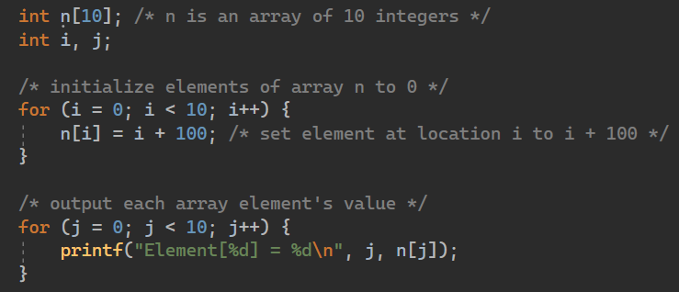
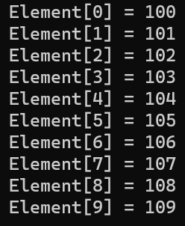
Arrays
Array Size: In C, the size of an array is determined at the time of declaration, and it cannot be changed during runtime. This means that once you declare an array with a specific size, it remains fixed. When declaring an array, you need to specify the size of the array based on the number of elements you want to store in it. For example, int numbers[5]; declares an array numbers that can store 5 integers. The size of the array is determined by the number specified inside the square brackets.
Iterating Over Arrays: Loops, such as for or while, are commonly used to iterate over array elements. By using a loop variable as the index, you can access each element of the array sequentially and perform desired operations.

Slide 39
Arrays
Multidimensional Arrays: C supports multidimensional arrays, which are essentially arrays of arrays. For example, a 2D array represents a table-like structure with rows and columns. Accessing elements in a multidimensional array involves using multiple indices to specify the position of the desired element.
The most common example of a multidimensional array is a 2D array, which represents a table-like structure with rows and columns. In C, a multidimensional array is declared using the following syntax:

Slide 40
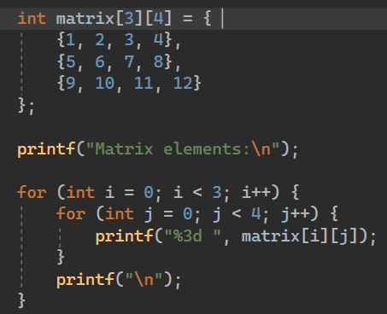
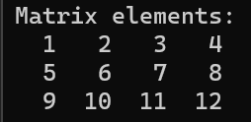
Arrays
Here is an example of making a 2D array:
The format specifier ‘%3d’ is used within the inner loop to create space between the columns. This is not strictly necessary but can be useful for formatting.
Note that the nested curly braces for each row are optional, but it is considered good practice to include them for purposes of readability.
In this example, we are using a nested for loop, where ‘i’ controls our rows, and ‘j’ controls our columns. The outer loop condition ‘i < 3’ ensures the loop will execute for each of the 3 rows. The inner loop will then iterate for each of the 4 columns of each row.

Slide 41
Functions / subprograms
Functions in C are self-contained blocks of code that perform a specific task. They encapsulate a set of instructions that can be called from different parts of a program. Functions help in organizing code, promoting reusability, and improving code readability.
In C programming, every program includes the main() function by default, and you have the flexibility to define additional functions based on the needs of your program.
By dividing your code into separate functions, you can logically organize different tasks. How you choose to divide your code among functions depends on your program's structure and requirements, but it is considered good practice for each function to do only one specific thing. This conforms to the principles of ‘clean code’.

Slide 42
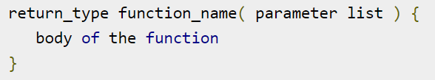
Functions / subprograms
In C, the basic structure of a function is as follows:
In C, a function typically has the following components:
Function declaration: It specifies the function's return type, name, and parameters (if any). It serves as a prototype for the function and allows the compiler to perform type checking. Note that some functions perform the desired operation without returning a value. In this case, the return_type is the keyword void.
Function definition: It contains the actual implementation of the function. It includes the function's body, which consists of a set of statements enclosed within curly braces that define what the function does.
Function call: It is the point in the program where the function is invoked or ‘called’. Functions in C follow a top-down execution flow, where the program starts from the main function and executes statements sequentially unless a function call is encountered. When a function call is encountered, the control is transferred to the called function, and once the function completes its execution, control returns to the caller.

Slide 43
Functions / subprograms
Functions in C have some differences compared to functions in other languages, especially modern languages. Some of the main differences are:
Function Overloading: In some languages, you can have multiple functions with the same name but different parameter lists. This is not supported in C. Each function in C must have a unique name.
Default Parameter Values: In some languages, you can assign default values to function parameters, so they are optional when calling the function. However, in C, you must explicitly provide a value for each parameter when calling the function. There are no default parameter values in C.
Exception Handling: Exception handling is a mechanism to handle errors or exceptional situations that can occur in a program. In C, there is no built-in support for exception handling like in some other languages. Instead, error handling is typically done using error codes or return values. Functions in C may return specific values to indicate errors or use other error handling techniques.

Slide 44
Functions / subprograms
Function Definitions and Prototypes: In C, it is common practice to declare functions before their first usage (typically before the main() function) and provide their definition separately. This helps the compiler understand the function's signature (return type, name, and parameters) before encountering its usage.
While it's not strictly necessary to place the function declaration outside the main() function, it's considered good practice for better code organization and readability. Placing the function declaration at the beginning of the file allows you to provide an overview of the functions used in the program, making it easier to understand the overall structure.
However, if you prefer, you can place the function declaration directly above its usage within the main() function. Just make sure the function definition appears somewhere in the code before it's called.

Slide 45
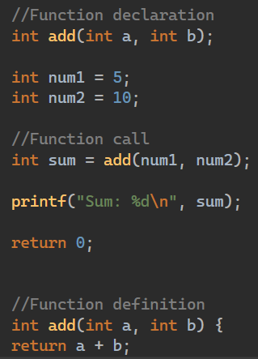
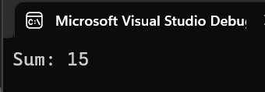
Functions / subprograms

Slide 46
Teacher Directed topics
I will be discussing Pointers, Strings (in depth), Structs Linked lists and if we have time some extra topics with you

Slide 47


